Slide 1


Final Presentation
Amaan Khan
amaan58231@gmail.com
Canada
York University
Data Analyst

Slide 2
Problem
Problem: Cross selling recommendation - Group Project - How to increase cross selling of Banking Product
Problem Description: The problem here is that they need to increase credit union’s cross selling. The bank wants to sell their customers more than one product.

Slide 3
Data Understanding
The data contains different types information:
Customer Demographics
Bank Products
Customer Economic information
Customer’s relationship with the bank
Residence information of the customer

Slide 4
Data Cleaning and Transformation
Handle missing values
Feature scaling
Data type conversion
Encoding categorical variables
Outlier treatment and detection

Slide 5
Customer Segmentation
- The largest number of customers belong to the ‘Particulares’ segment, making up approximately 59.15% of the total customer base.
- The ‘Universitario’ segment is the second biggest one, with around 36.67% of the customers.
- The ‘Top’ segment is the least amount, with only about 4.18% of the customers.

Slide 6
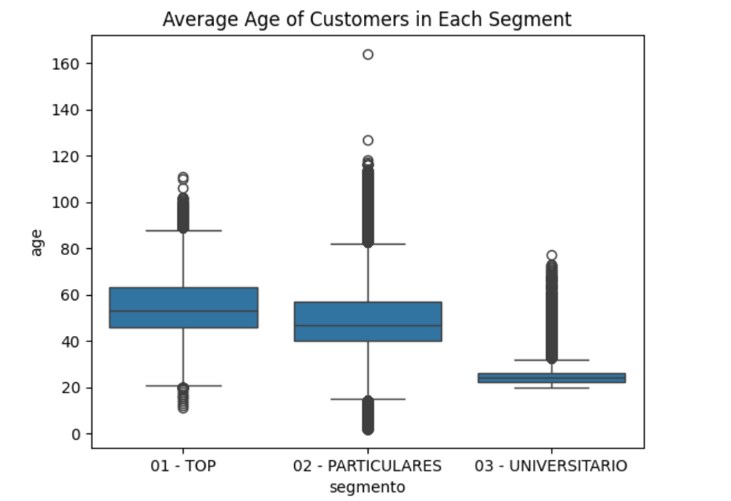
Customer Age

Slide 7
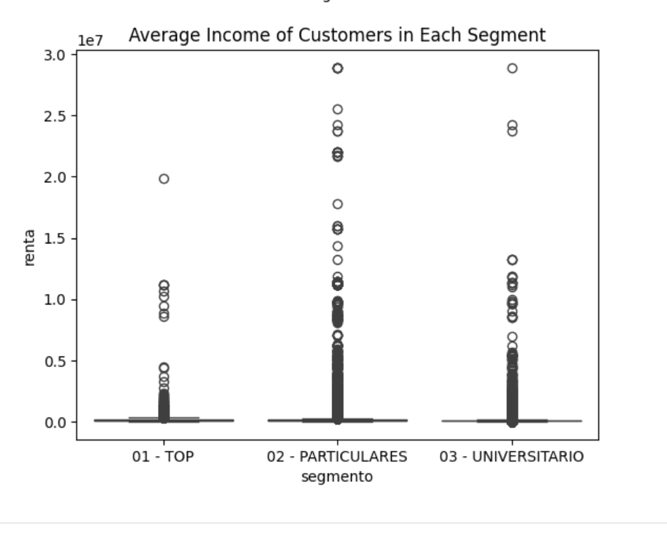
Income

Slide 8
Dashboard
- The largest number of customers belong to the ‘Particulares’ segment, making up approximately 59.15% of the total customer base.
- The ‘Universitario’ segment is the second biggest one, with around 36.67% of the customers.
- The ‘Top’ segment is the least amount, with only about 4.18% of the customers.
KPIs:
- Cross Sell Ratio, Product Penetration Rate, Revenue from Cross Selling, Customer Retention Rate

Slide 9
EDA Recommendations
TARGETED MARKETING: The bank should try to target higher paid customers some high value banking products or investment opportunities
PRODUCT CUSTOMIZATION: The bank should offer different age groups different things. For example, seniors could be offered retirement products or accounts.
Bank should also offer products to young adults and students, like student accounts or tuition loans.

Slide 10
Model Recommendations
Decision Trees
Random Forest
Gradient Boosting
Support Vector Machines
Logistic Regression

